Slide 1

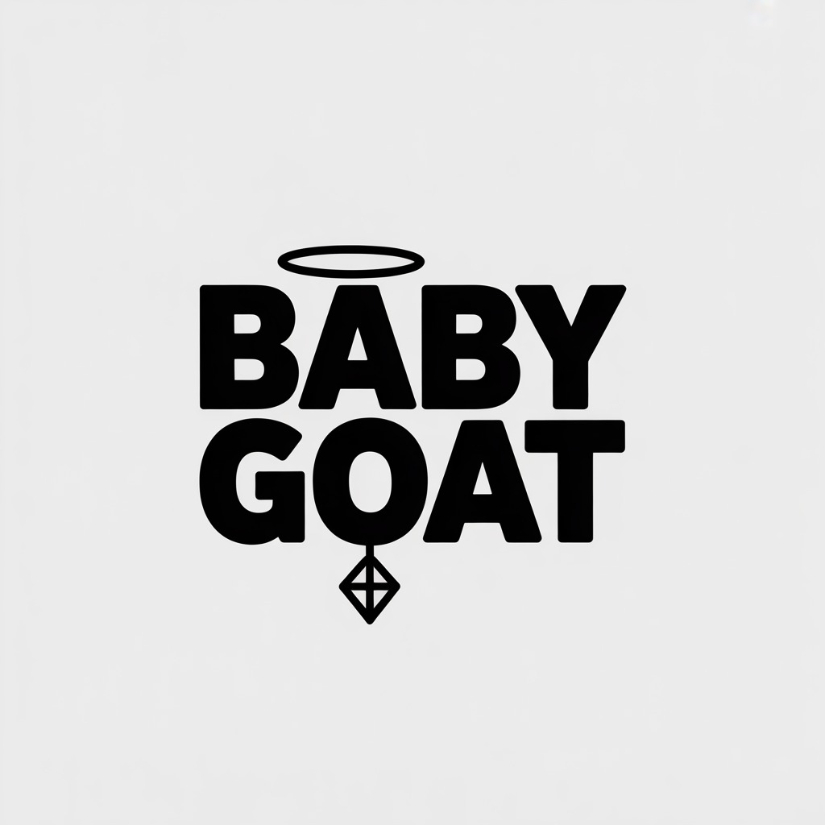
BABY GOAT APPAREL: BREAKING THE BOTTLENECK
Luxury Street Apparel
Built Different
Worn Proud

Slide 2
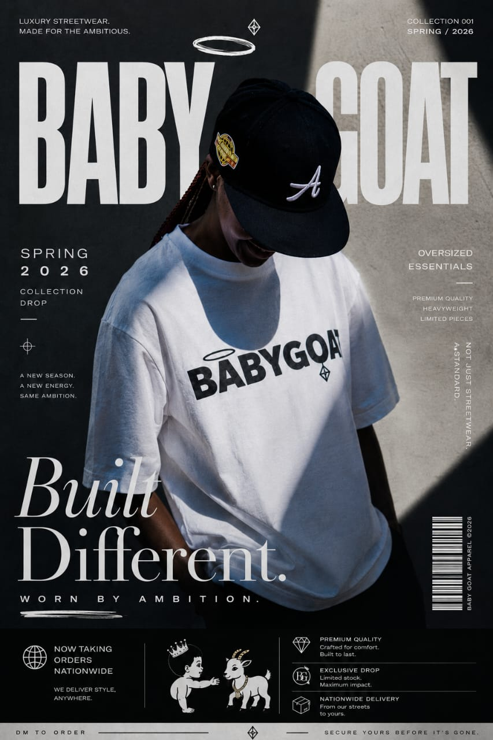
The Problem & The Gap
South Africa’s streetwear market is broken
Option A: Cheap, mass-produced shirts that pill and shrink after three washes.
Option B: Overpriced international imports that have zero connection to our local culture and cost a fortune to ship.
The Gap: Customers—whether they are 19 or 59—want premium quality without the import price tag. They want fabric that feels expensive, cuts that fit real bodies, and a brand that actually represents them.
BABY GOAT bridges that gap.

Slide 3
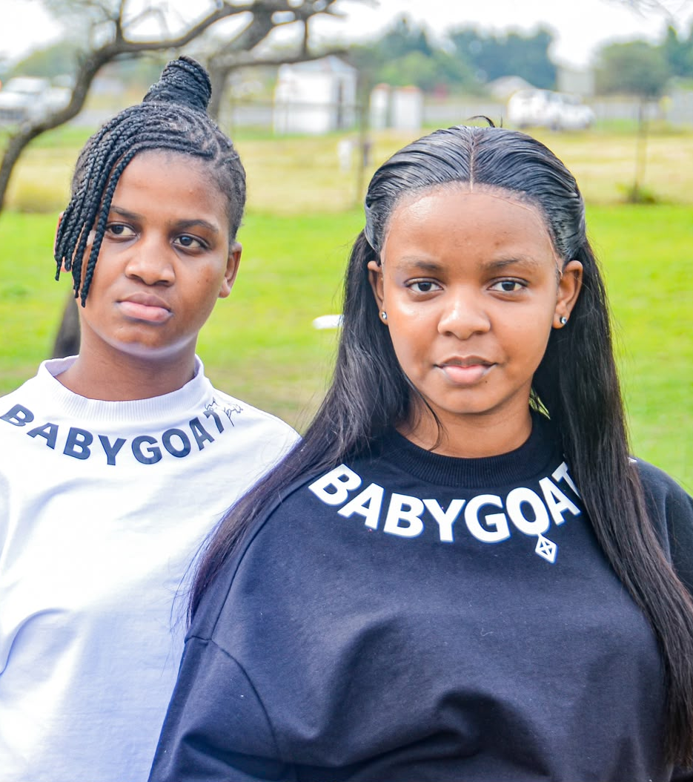
The Brand DNA
This isn't a clothing line; it's a uniform for confidence.
Our Mission: To outfit bold, creative, and ambitious people with apparel that lasts—not fast fashion that ends up in a landfill.
Our Vision: To take a kitchen-table studio in Pietermaritzburg and build a local luxury-street label that competes with the global big boys.
Our Core Value: We are "Boldly Humble." We are small, but we don't play small. We respect the craft, we respect our customers of all ages, and we respect the streets that raised us.

Slide 4
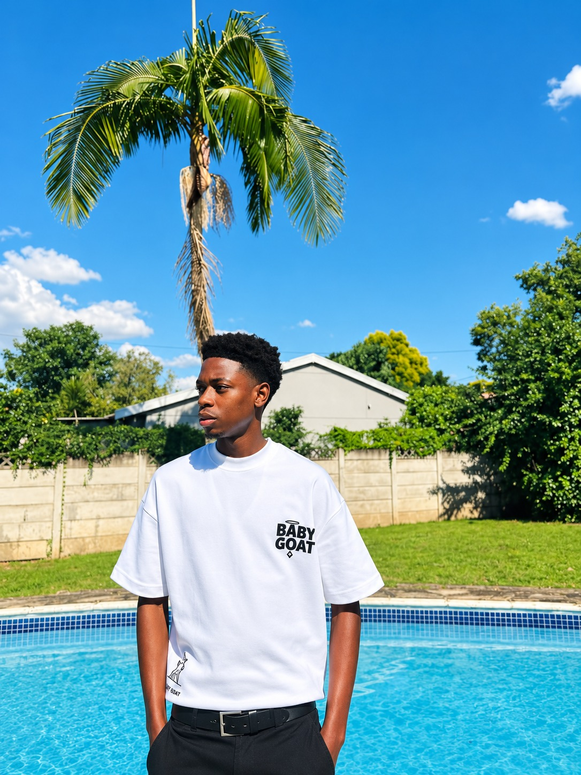
The Fabric & The Unboxing
We don’t cut corners. From the fabric to the bag
The Fabric: We use a premium Scuba fabric for our flagship piece that structurally identical to what you’d find in a ZARA tier garment. It has a smooth, elevated drape. We also offer 300gsm boxy heavyweights and breathable 200gsm organic cottons.
The Ritual (Packaging): We don't throw tees in a cheap plastic bag.
  The garment goes into a custom BABY GOAT aesthetic paper bag.
  Sealed in a branded, modern poly-mailer (similar durability to SHEIN, but customized to our visual identity).
  And the note: Instead of printing a separate waste card, we hand-write a personalized thank-you directly on the invoice itself. It’s warm, personal, and zero waste.

Slide 5
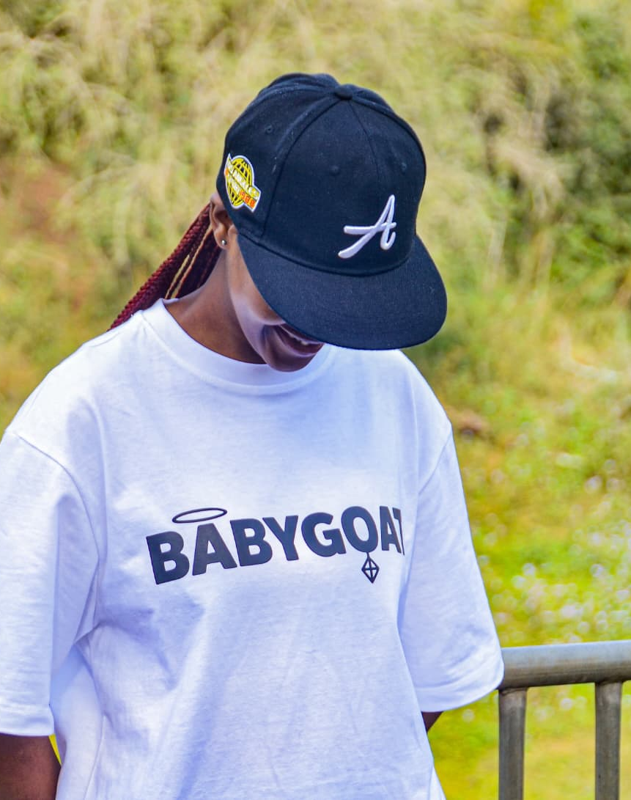
The Proving Ground
We don't pitch hypotheticals. We pitch sold-out stock
We launched in July 2026 from my home studio with zero external funding and zero debt.
The result was a 100% sell-out of our inventory.
Revenue: R 4,755.00 generated.
Gross Margin: 65.5% (Proving people are willing to pay premium prices for what we make).
Net Profit (After Tax): R 1,397.95 in pure profit, sitting in the bank.
The Problem: Our social media engagement is high, our quality is proven, but our capacity is capped.

Slide 6
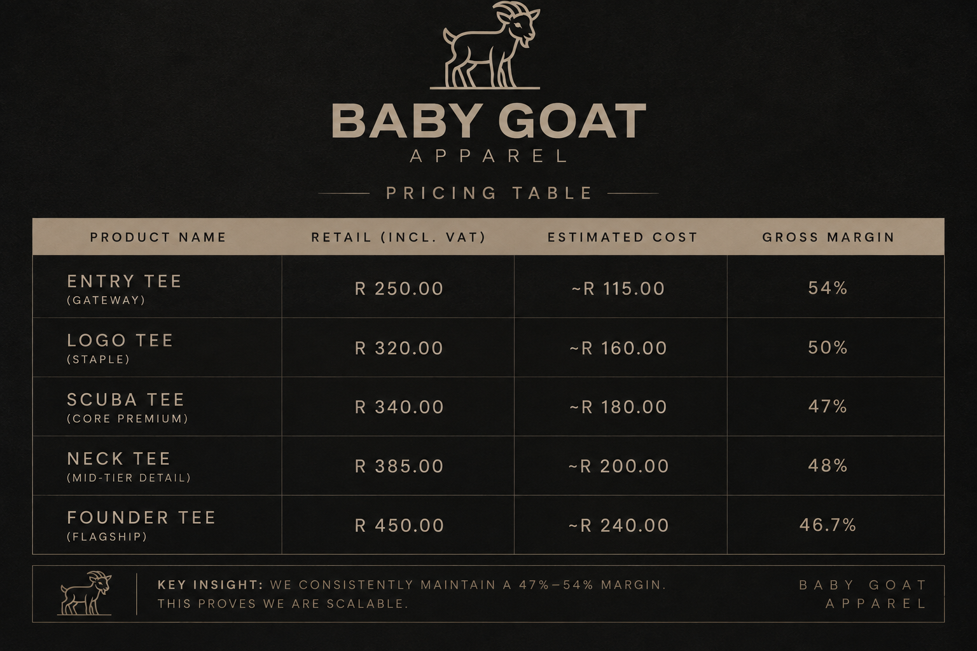
Our Product Ecosystem

Slide 7
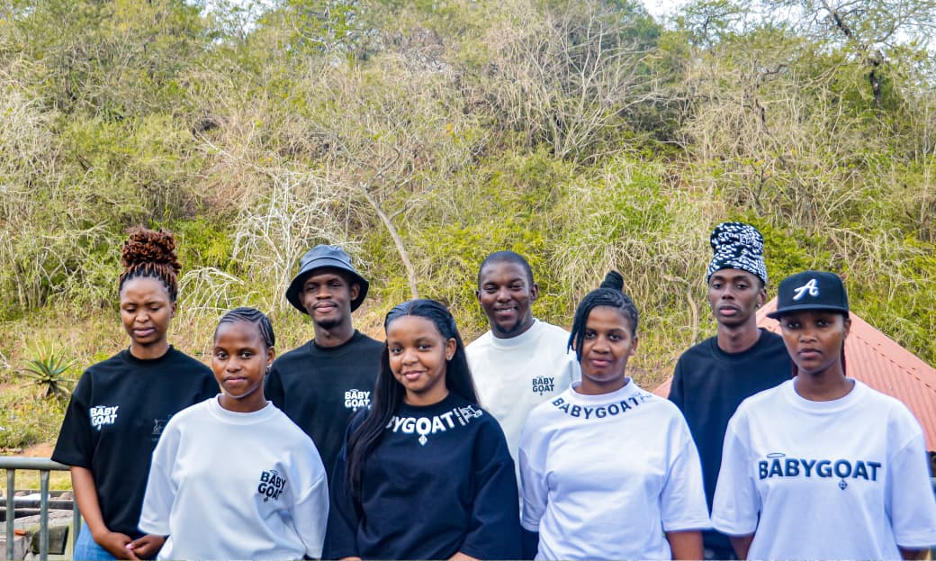
The Brutal Bottleneck
Right now, we are buying fabric one tee at a time. It’s financially crippling
Currently, our cash flow forces us to use a "per-order, custom-make" model.
We use one single, reliable supplier. But because we don't have bulk capital:
  We buy the fabric after a customer orders.
  The supplier custom-makes the tee specifically for that order (5-day wait).
  We ship it individually.
The result: We cannot cater to a huge number of orders. We lose sales every single week because we can't front the cost of raw materials. We are stuck in a hand-to-mouth production cycle.

Slide 8
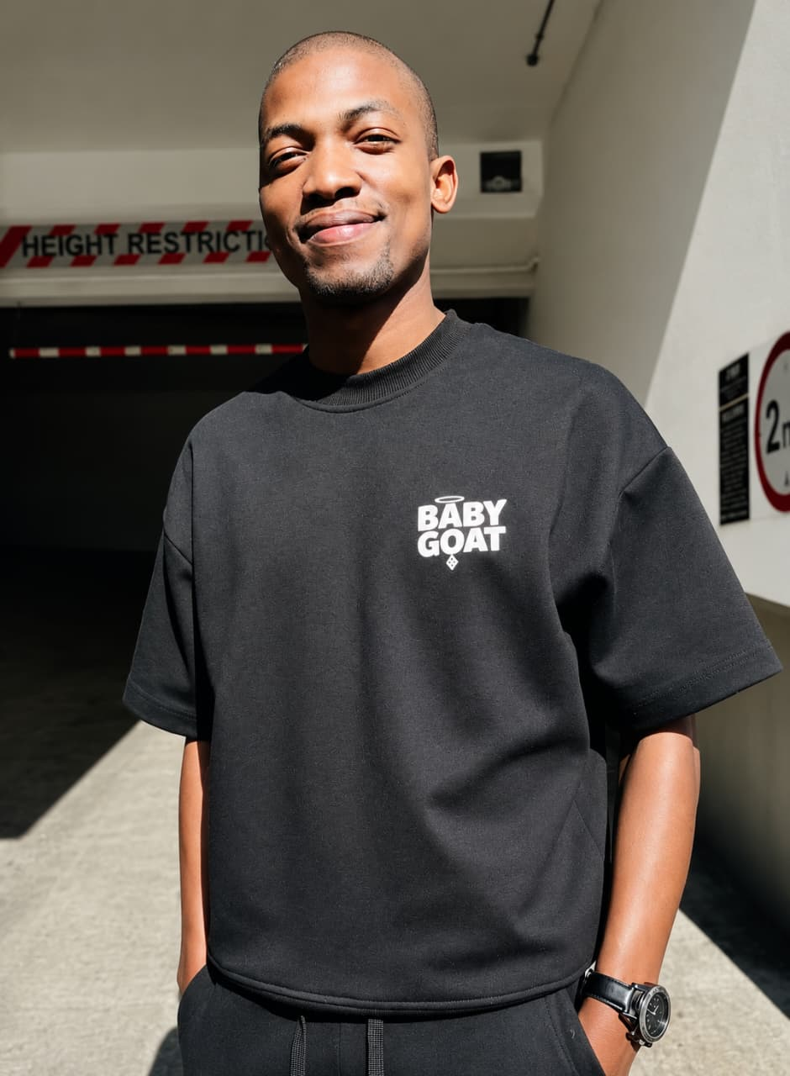
The Marketing Strategy
We don't just post pictures. We provoke action.
FOMO Drops: We move away from "always available" to strict, announced drop dates (e.g., "20 units, August 15th, 8 PM"). Scarcity forces the follower to commit.
UGC & Fit-Checks: We are killing static stock photos. 80% of our content will be unpolished, authentic Reels/TikToks of real humans wearing the tees in natural sunlight.
Direct DM Monetization: We do not wait for the "Link in Bio" to work. We proactively DM followers who engage with our posts and offer them a direct pre-order link. It builds a boutique relationship and moves them out of the feed immediately.

Slide 9
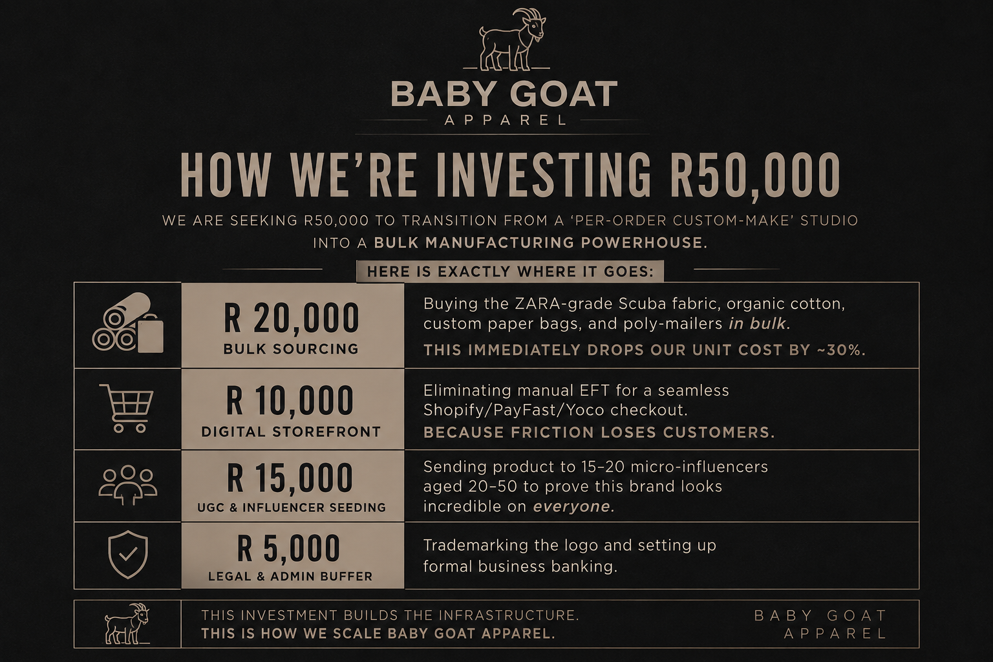
The Investment Ask (The R 50,000)

Slide 10
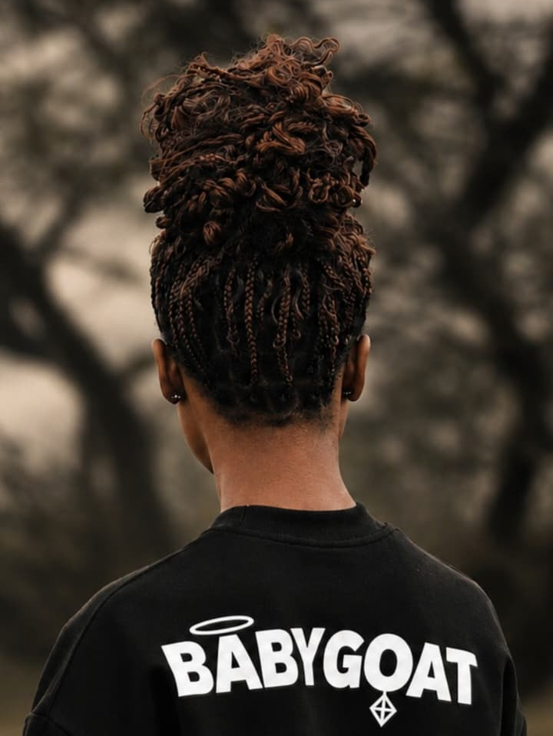
The Projections
Why R50k makes perfect financial sense.
Because we are currently buying one tee at a time, our Scuba Tee costs ~R180 to make.
With bulk buying, that drops to ~R120 per unit.
The math: Our average selling price is roughly R340. That means we make R220 profit per tee.
We only need to sell 238 tees to completely pay back the entire R50,000 investment.
Our roadmap targets 40 units a month. Over 6 months, that is 240 units.
Conclusion: The R50k investment will have fully paid for itself within 6 months. After that, everything is pure profit.

Slide 11
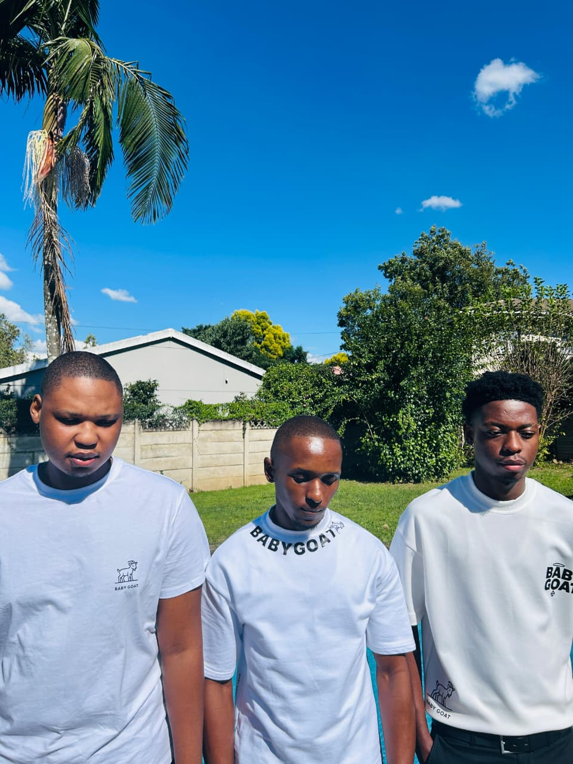
The Founders & The Closing
Investors don't bet on trends. They bet on founders who solve bottlenecks.
We are Wandile Zulu, Sphesihle Mgojo, and Njabulo Nyathi. Three founders, one studio in Pietermaritzburg, and a single shared mission: build a luxury-streetwear label South Africa can be proud of.
Together, we have already built a 65.5% margin product, proven real demand, and achieved a 100% sell-through rate in our first month—all while battling a hand-to-mouth, per-order cash-flow model.
We aren't asking for a loan to survive. We are asking for the fuel to take what three of us have already proven works—and scale it to the volume it deserves.
Give us R50,000. We will buy the materials in bulk. We will cut our wait times from 5 days to 0. We will serve our waiting customers. We will pay you back in 6 months.
Built Different. Worn Proud.

Slide 12
BABY GOAT APPAREL
That's the honest breakdown of where we stand. We know the R50k isn't pocket change, but we also know we've already proven the demand. Our question to you is: based on our margins and our 6-month payback math, what's your initial gut feeling on this?

